Slide 1
江西财经大学 文学系学术答辩 PPT
Jiangxi University of Finance and Economics
author / Meimei Han
Notes:
51PPT模板网，幻灯片演示模板及素材免费下载！
51PPT模板网 唯一访问网址：www.51pptmoban.com

Slide 2
01
Contents
Text here
Copy paste fonts. Choose the only option to retain text…...
02
Text here
Copy paste fonts. Choose the only option to retain text…...
03
Text h ere
Copy paste fonts. Choose the only option to retai n text…...
04
Text h ere
Copy paste fonts. Choose the only option to retai n text…...

Slide 3
01
Edit Master text styles
Theme color make s PPT more convenient to change.
Adjust the spacing to adapt to Chinese typesetting, use the reference line in PPT.

Slide 4

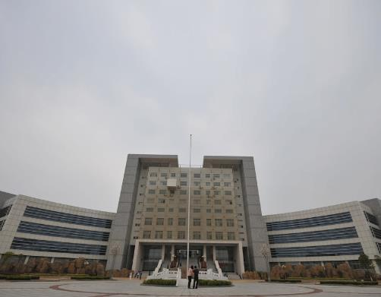
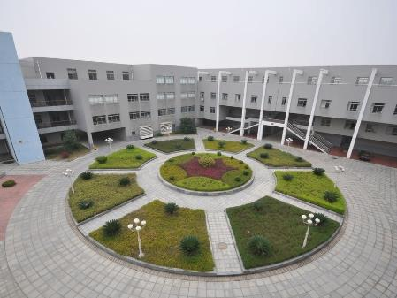

Copy past e fonts. Choose the only option to retain text.
Te xt here
Copy past e fonts. Choose the only option to retain text.
Text here

Slide 5
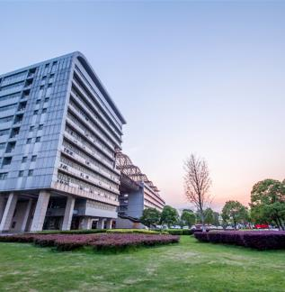

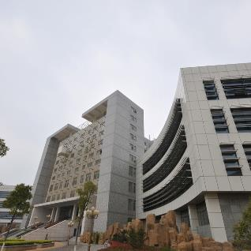

Text here
Text h ere
Copy paste fonts. Choose the only option to ret ain text.
……
Text h ere
Copy paste fonts. Choose the only option to ret ain text.
……
…text
Text h ere
Copy paste fonts. Choose the only option to ret ain text.
……
Text h ere
Copy paste fonts. Choose the only option to ret ain text.
……

Slide 6
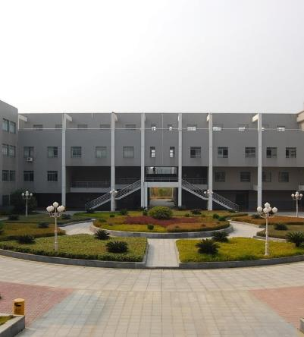
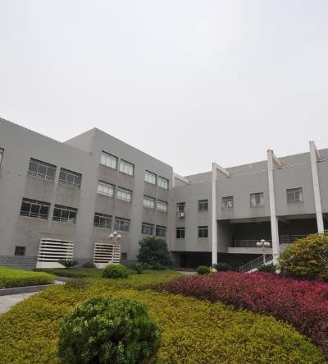
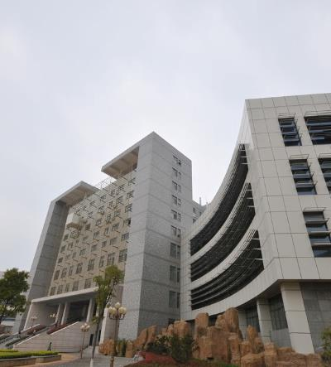
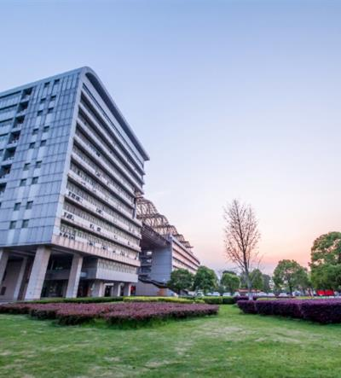
Unified fonts make reading more fluent.
1
2
3
4
Te xt
Te xt
Te xt
Te xt
Supporting text here.
Supporting text here.
……
Supporting text here.
Supporting text here.
……
Supporting text here.
Supporting text here.
……
Supporting text here.
Supporting text here.
……

Slide 7

Text here
Text here
Copy paste fonts. Choose the only option to retaintext……
Copy paste fonts. Choose the only option to retaintext……
Text here
Text here
Copy paste fonts. Choose the only option to retaintext……
Copy paste fonts. Choose the only option to retain text……
Text here
Text here
Text here
Copy paste fonts. Choose the only option to retain text……
Copy paste fonts. Choose the only option to retain text……

Slide 8
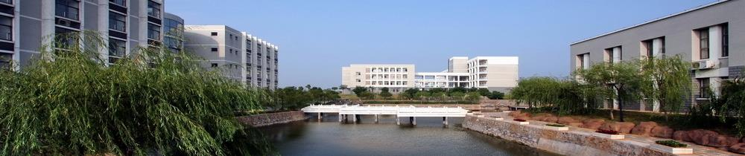
2 017
Text He re
2 018
Supporting text here
Supporting text he re
…
2 016
Text He re
Text He re
Supporting text here
Supporting text he re
…
Supporting te xt here
Supporting text here
…
Tex t Here

Slide 9
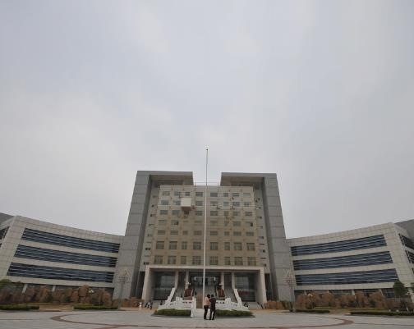
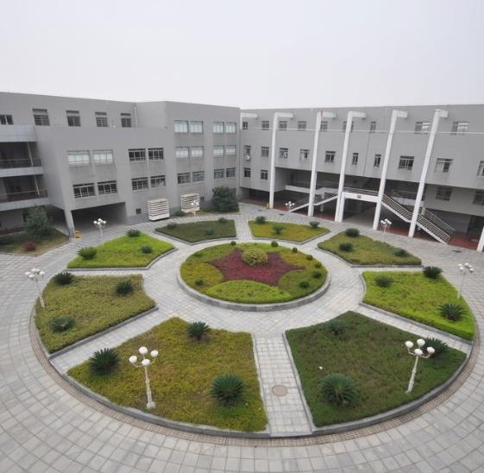

Text h ere
Te xt here
Te xt here
Copy paste fonts. Choose the only option to retain text.….
Copy paste fonts. Choose the only option to retain text.….

Slide 10
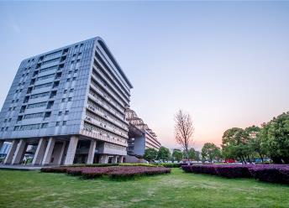
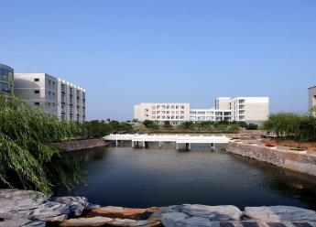

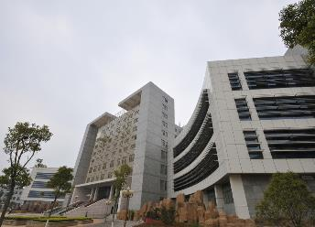
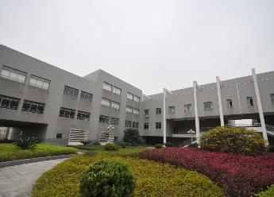
Unified fonts make reading more flu ent.
Text he re
Text he re
Text here
Text here
Text here
Supporting text here.
……
Support ing text here.
……
Supporting text here.
……
Supporting text here.
……
Supporting text here.
……

Slide 11
Text here
Text He re
Text H ere
1.Supporting text here
Supporting text here
2.Supporting text here
Supporting text here
3.Supporting text here
Supporting text here
4.Supporting text here
Supporting text here
5.Su pporting text here
Supp orting text here
6.Su pporting text here
Supp orting text here
7.Su pporting text here
Supp orting text here

Slide 12

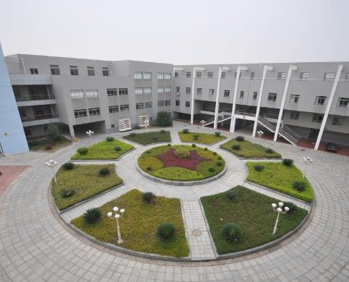
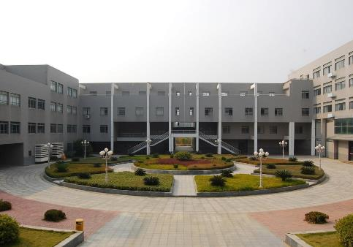
Copy paste fonts. Choose the only option to retain text.
8 0%
Tex t here
Text here
77%
Text here
42%
Text here
71%
Text here
54%
Notes:
51PPT模板网，幻灯片演示模板及素材免费下载！
51PPT模板网 唯一访问网址：www.51pptmoban.com

Slide 13
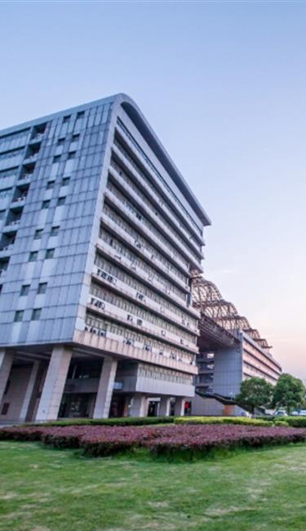
63%
Text here
Supporting text here.
Supporting text here.
……
Text here
Supporting text here
19%
Supporting text here.
Supporting text here.
……
Supporting text here.
Supporting text here.
……
Text here
Supporting text here

Slide 14
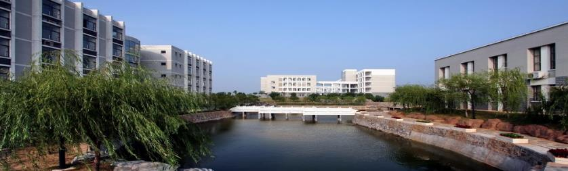


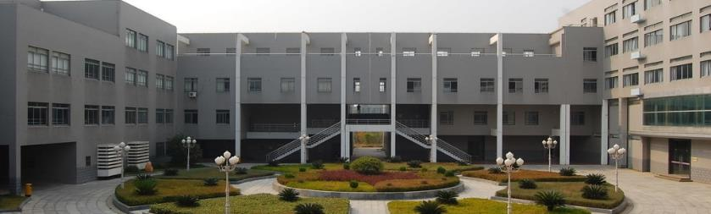
… Text
…T ext
Copy paste fonts . Choose the only option to retain text…...
Copy paste fonts. Choose the only opt ion to retain text…...
… Text
…T ext
Copy paste fonts. Choose the only opt ion to retain text…...
Copy paste fonts. Choose the only opt ion to retain text…...

Slide 15
Text h ere
Text h ere
Text h ere
Te xt here
Supporting text her e
… …
Supporting text her e
… …
Supporting text her e
… …
Suppo rting text here
… …
Supporting text her e
… …
Suppo rting text here
… …
Suppo rting text here
… …
Suppo rting text here
… …

Slide 16

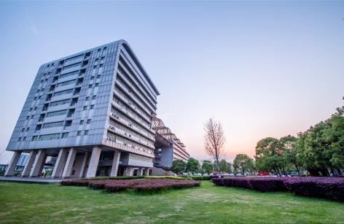

Text here
Text here
Supporting text here.
Supporting text here.
……
Text here
Supporting text here.
Supporting text here.
……
Text here
Supporting text here.
Supporting text here.
……

Slide 17
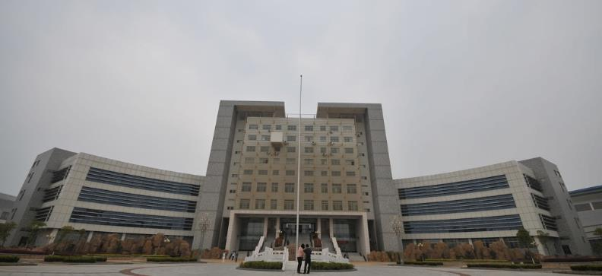
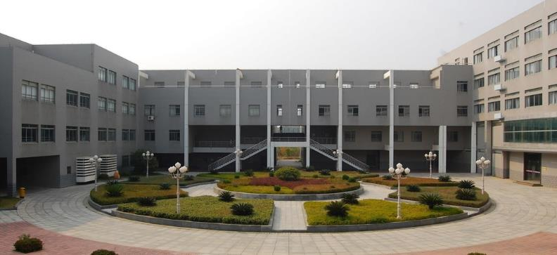
Text here
8 0%
8 0%
Copy paste fonts. Choose the only option to reta in text.
Copy paste fonts. Choose the only option to reta in text.

Slide 18
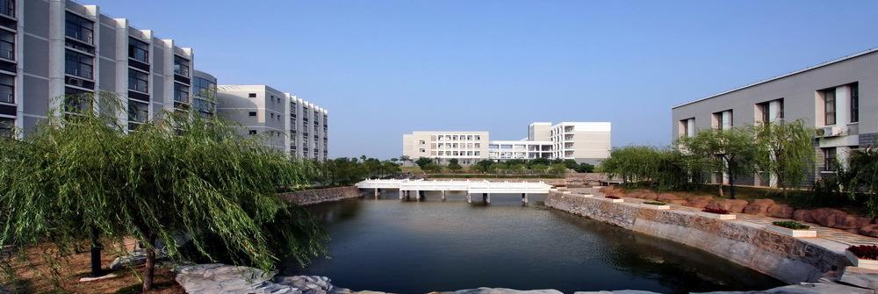
Text here
Text here
Text here
Text here
Text here
Text here
Text here
Supporting text here.
……
Supporting text here.
……
Supporting text here.
……
Supporting text here.
……
Supporting text here.
……
Supporting text here.
……

Slide 19
Text here
Copy paste fonts. Choose t he only option to retain text.….
Copy paste fonts. Choose t he only option to retain text.….
Copy paste fonts. Choose the only option to re tain text.….
Copy paste fonts. Choose the only option to re tain text.….
Text here
Text here
Text here
Text here

Slide 20
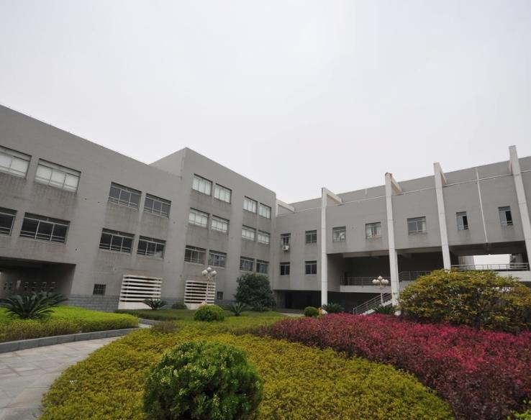

Unified fonts make r eading more fluent.

Slide 21




Text here
Text here
Text here
Text here
Supporting text here.
Supporting text here.
Supporting text here.
……
Supporting text here.
Supporting text here.
Supporting text here.
……
Supporting text here.
Supporting text here.
Supporting text here.
……
Supporting text here.
Supporting text here.
Supporting text here.
……

Slide 22
Unified fonts make reading more fluent.
Theme color makes PPT more convenient to change.
Adjust the spacing to adapt to Chinese typesetting, use the reference line in PPT.
Text here
Text here
Text here
Copy paste fonts. Choose the only option to retain text.
……
Copy paste fonts. Choose the only option to retain text.
……
Copy paste fonts. Choose the only option to retain text.
……

Slide 23
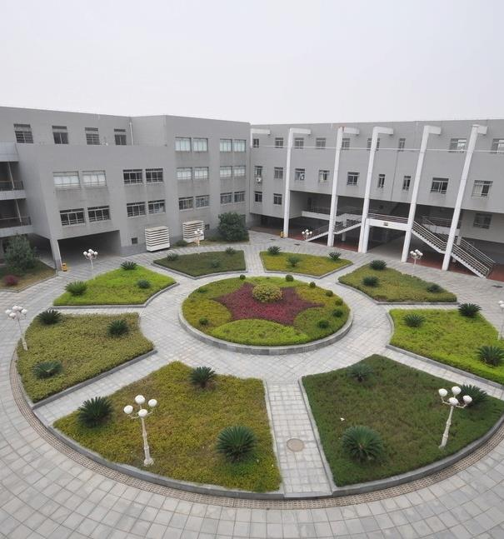
Unified fonts make reading more f luent.
Theme color makes PPT more conve nient to change.
Adjust the spacing to adapt to Chinese typesetting, use the reference line in PPT.
… …
Text here
Text here
Text here
Supporting text here.
… …
Supporting text here.
… …
Supporting text here.
… …

Slide 24

Text here
Text here
Text here
Text here
Copy paste fonts. Choose the only option to retain text.
Copy paste fonts. Choose the only option to retain text.
……
Copy paste fonts. Choose the only option to retain text.
Copy paste fonts. Choose the only option to retain text.
……
Copy paste fonts. Choose the only option to retain text.
Copy paste fonts. Choose the only option to retain text.
……
Copy paste fonts. Choose the only option to retain text.
Copy paste fonts. Choose the only option to retain text.
……

Slide 25
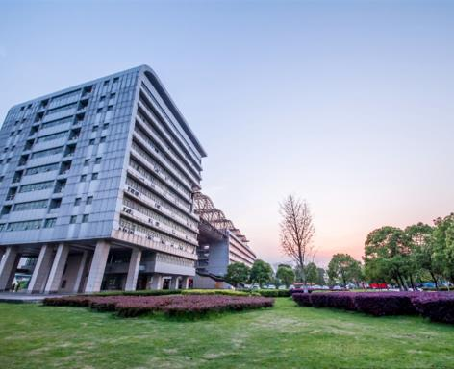
Text here
Copy paste fonts. Choose the only option to retain text……
Text here
60%
46%
Text here
Text he re
67%
Copy paste fonts. Choose the only option to retain text…...
83%

Slide 26
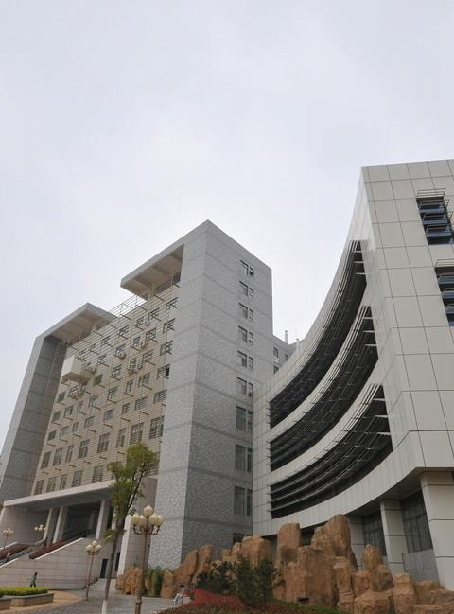
Suppor ting text here.
Unified Fo nts Make
Reading More Fluent.
Unified fonts make reading more fluent.
Theme color makes PPT more convenient to change.
Adjust the spacing to adapt to Chinese typesetting, use the reference line in PPT.
……

Slide 27
Text here
Text here
Text here
Text here
Text here
Tex t here
Supporting text here.
Supporting text here.
Supporting text here.
Supporting text here.
Supporti ng text here.
……
……
……
……
… …
……
……
……
……
… …
……
……
……
……
… …

Slide 28
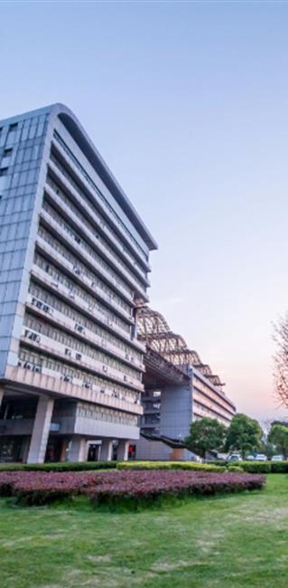
Text here
Unified fonts make
reading more fluent.
Copy paste fonts. Choose the only option to retaintext.
Theme color makes PPT more convenient to change.
Adjust the spacing to adapt to Chinese typesetting, use the reference line in PPT.
Text here
Copy paste fonts. Choose the only option to retaintext.

Slide 29
THANKS
Theme color makes PPT more convenient to change.Adjust
the spacing to adapt to Chinese typesetting, use the reference
line in PPT.

